Slide 1
Re Imagining a DPI Approach to Urban Planning
Vishnu Shashank
Fellow, people +ai
in collaboration with eGov Foundation

Slide 2
India is undergoing Rapid Urbanization
Census 2011 – 31.4% Urban Population - 377 Million
The Current Population of the USA – 335 Million
Estimates suggest that 590 Million live in cities by 2030 (NIUA)
Still an Underestimated Issue - trickles down to the definition of Urban
World Bank – UAI Estimates – 55.3% of Indian Settlements
EU Study on Global Settlement Footprint – 66%

Slide 3
Contributors to this Rural-Urban Transition
Social Factors
Industrialisation
Employment
Land Fragmentation
Climate Issues
Urbanisation occurs not due to urban pull but due to rural push.
Better Quality of Life
Notes:
. Because of fertility decline, the country has a high percentage of population in the working age group (15–59 years) and this is likely to go up further in the next three or four decades.

Slide 4
Current Mechanism to Plan and Manage Cities
Planning in Cities should now be a Multi Dimensional Aspect
Solely Spatial Entity
Is a Rigid Static Entity
Little to No Tech

Slide 5
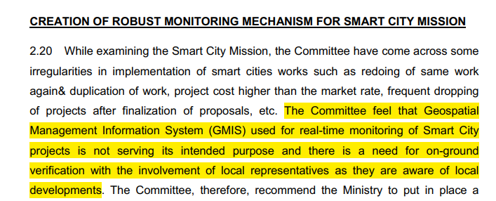
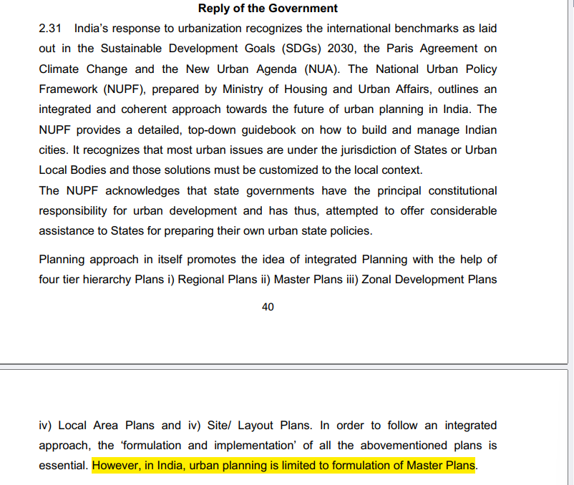
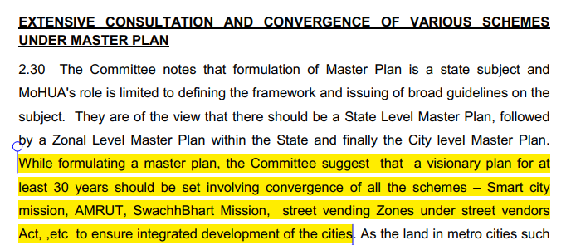
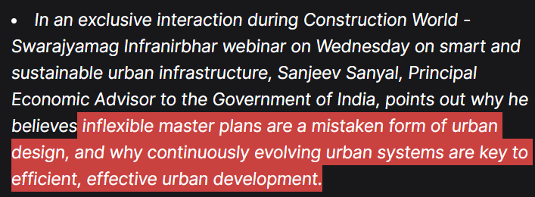
Smart Cities (?)
Report on the Parliamentary Standing Committee on Urban Reforms -

Slide 6
Typical Contents of a Master Plan
Background and History
Regional and Physical Settings
Demography
Economy
Land Profile
Shelter
Physical Infrastructure
Water Supply
Sewerage
Storm Water
Solid Waste
Social Infrastructure
Education
Healthcare
Police
Fire
Parks and Recreation
Disaster Management

Slide 7
Functionally Breaking Down
Vision
Plan
Demography
Economy
Land Profile
Manage
Water Supply
Sewerage
Storm Water
Solid Waste
Social Infrastructure
Education
Healthcare
Police
Fire
Parks and Recreation
Disaster Management

Slide 8
The Problem(s)
Not enough Planners
No Flow between organizations, actors and Implementation agencies
No Symbiosis between demography – spatial growth and incidental infrastructure
Departments operate according to their own Standards - guidelines
Urban Management is largely an Interoperability Problem

Slide 9
Re-imagining a Master Plan
Dynamic , not Static
Stringent, not Rigid
Not a Map / Document , but a live - dynamic - database

Slide 10
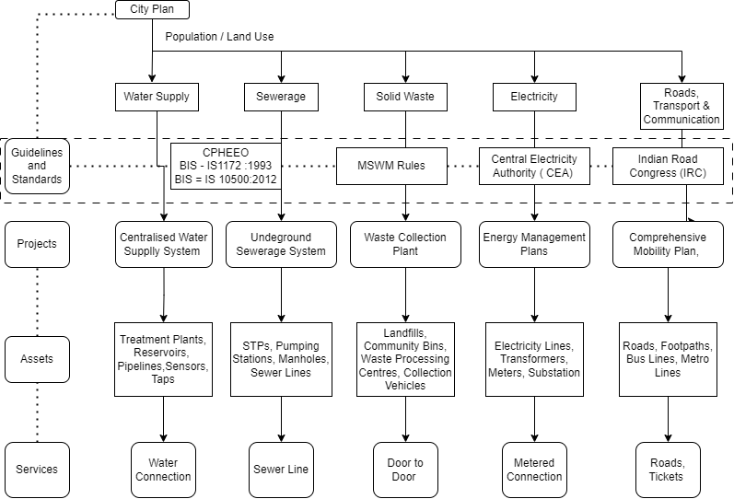
Current Decision Tree in a City (Infrastructure)
Level 1 Bureaucrats
Commissioners, Chairperson
Chief Engineer etc.
Level 2 - Administrators
Assistant Engineers, Engineers
Level 3
Supervisors,
Assistant Supervisors
Level 4
Surveyors, Inspectors, Frontline Workers

Slide 11
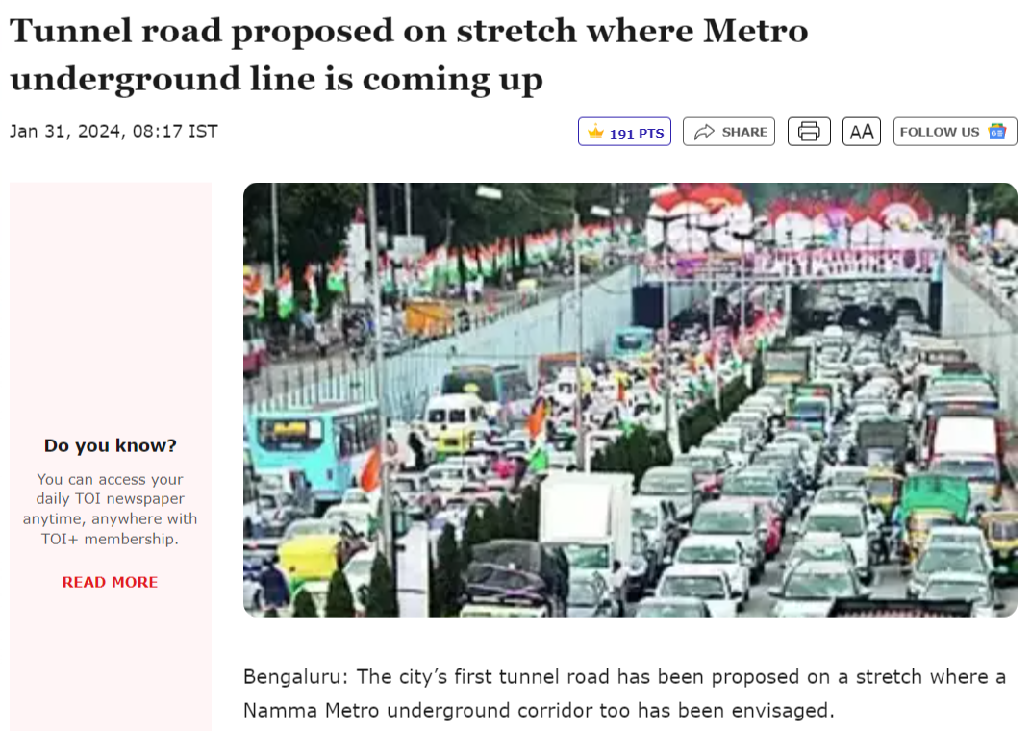
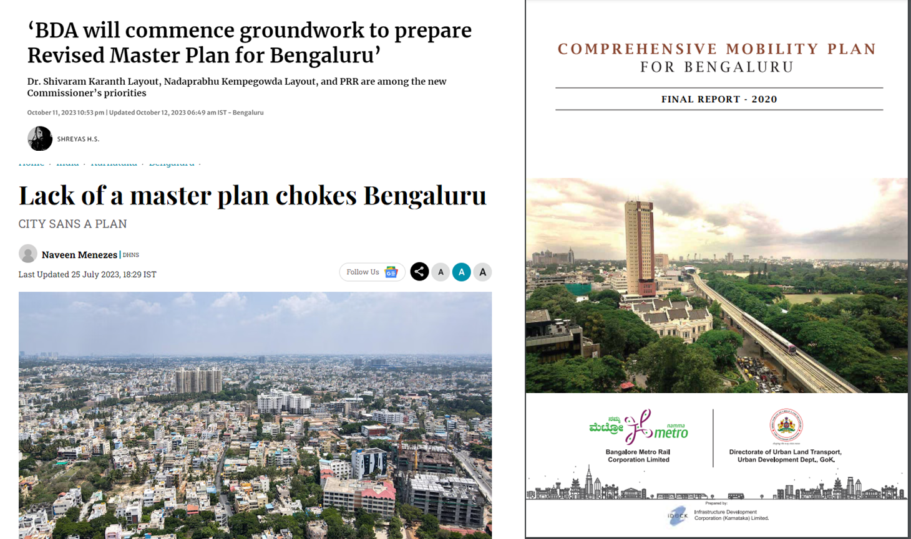
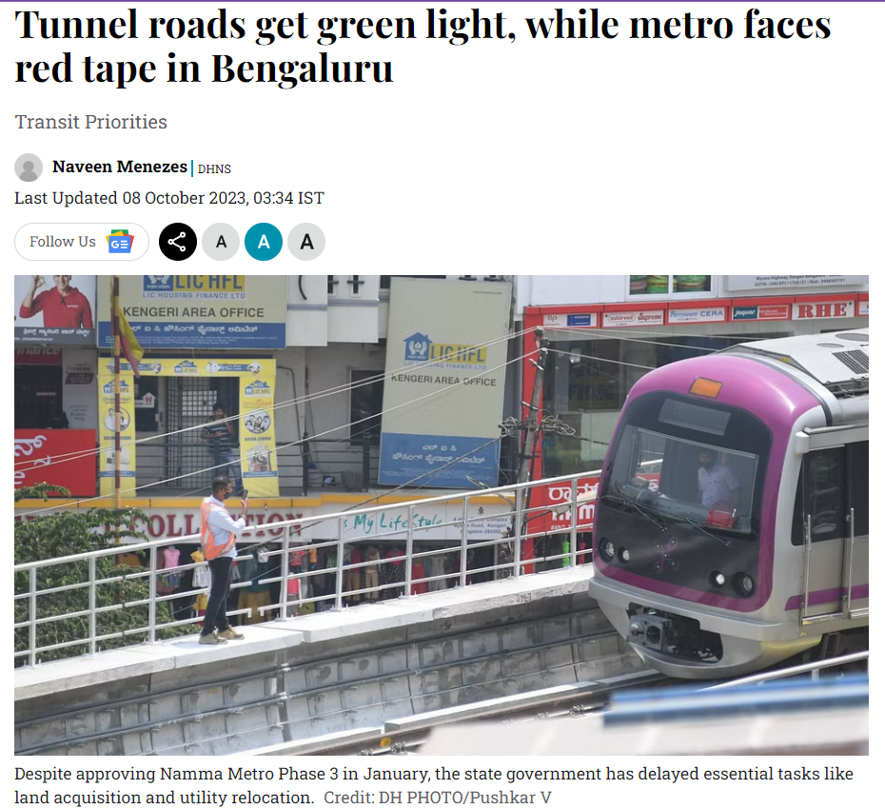
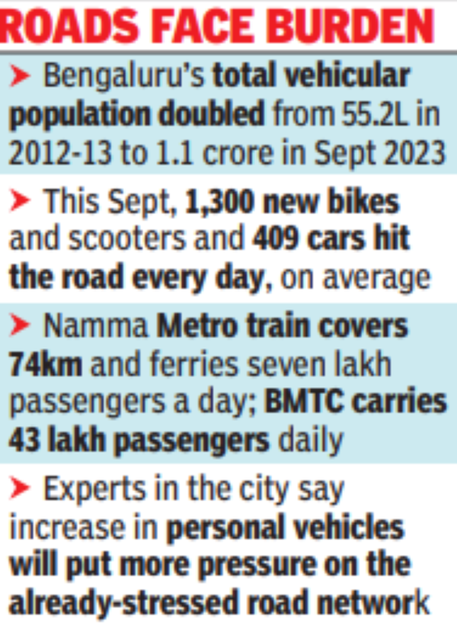
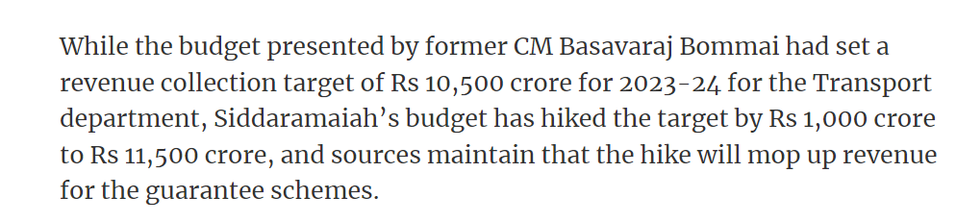

Slide 12
Ideal Decision Tree in a City

Slide 13
: Singapore URA Demo – A Digital Master Plan

Slide 14
Intensification of Interaction – Crux of Solving the Urban problem
Codify Standards - Individual Standards , Guidelines to be Digitally Codified - Start with DCRs (State/ Town)
Codify The Master Plan - GIS based Master Plans should be converted to GeoDatabases
Link them through Geospatial Repositories - Translate them through GDBs - interactive GeoJSON APIs?
Location + Cadastral Data = Ultimate Unique Identifier??? - To test out

Slide 15
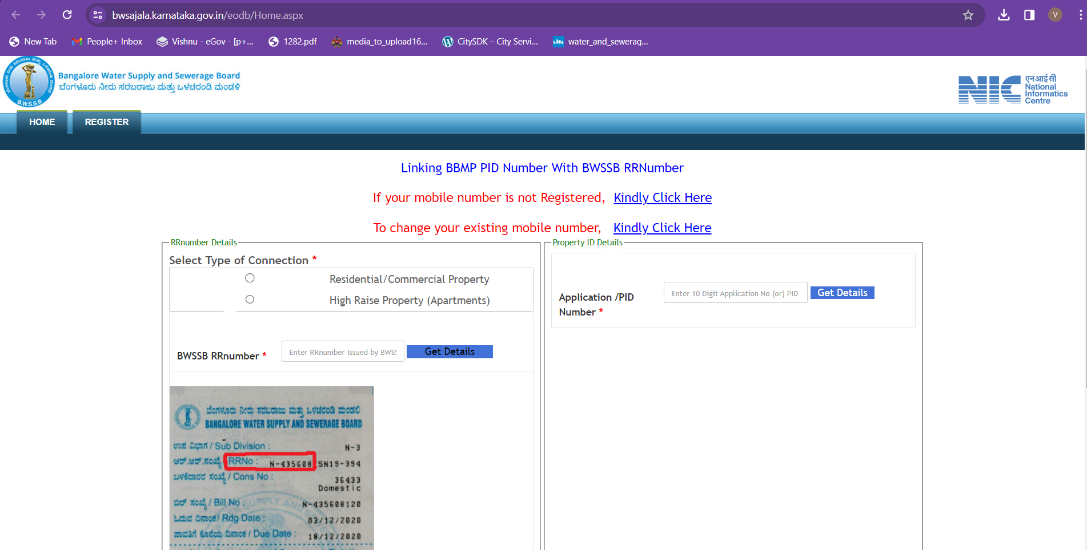
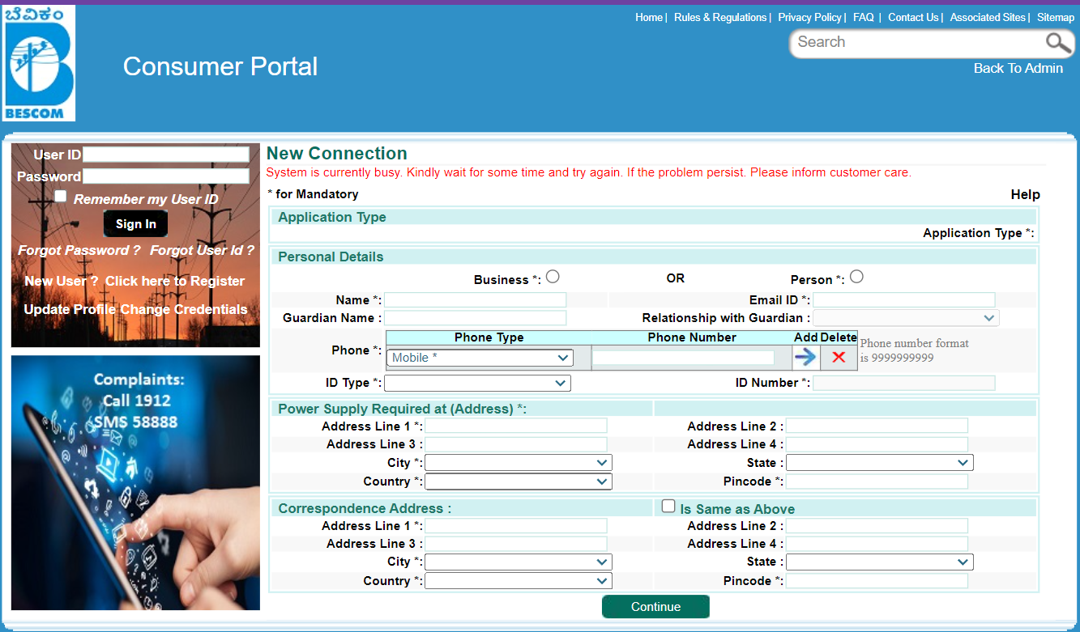
Way Forward
Data Tie-ups – Digitized Set (Civic End)
Identify Unique Identifier at each Service End
Demonstrate Data Interoperability through Unique Identifiers

Slide 16
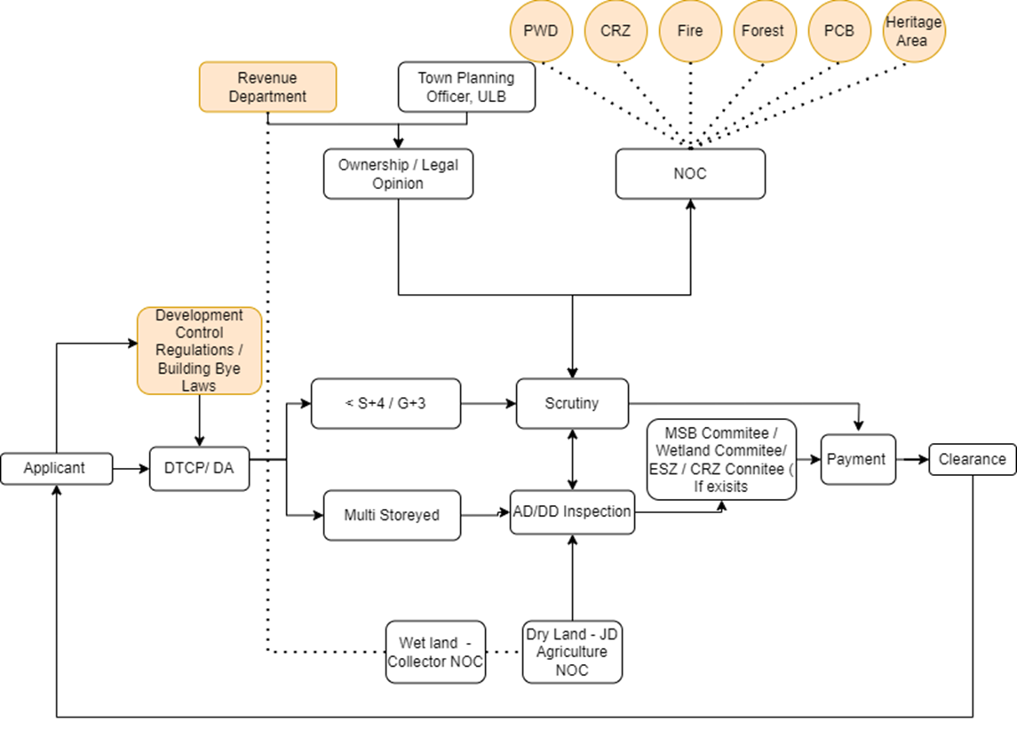
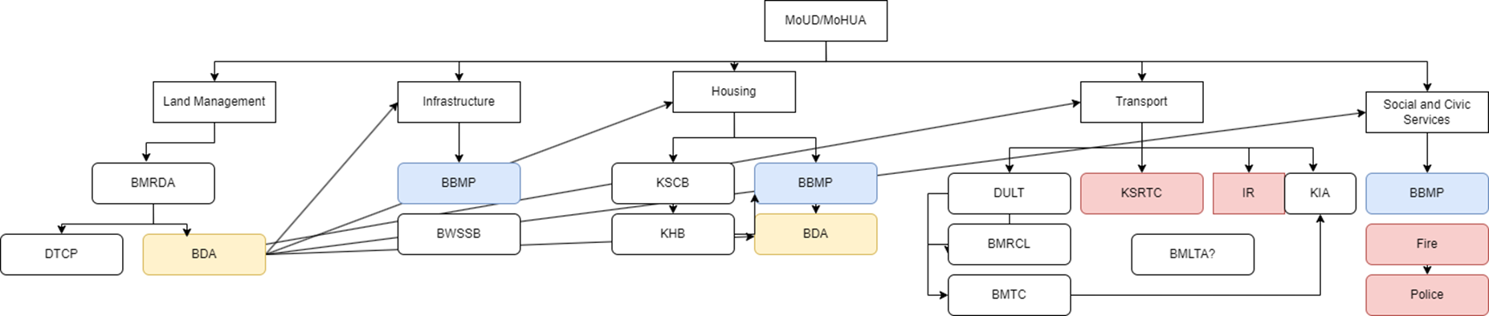
Way Forward
Use Case 1 - Building Permissions - Greenfield Development
Tangible Outcomes
Citizen - Ease of Form Filling and Data Application
ULB : Significant time Reduction in Site Inspection
ULB/ Government : Data Augmentation and Ease in Decision making, Ability to track Urban Sprawl

Slide 17
Way Forward Use Case 2 – Strengthening Institutional Decision Making Capacity

